Slide 1
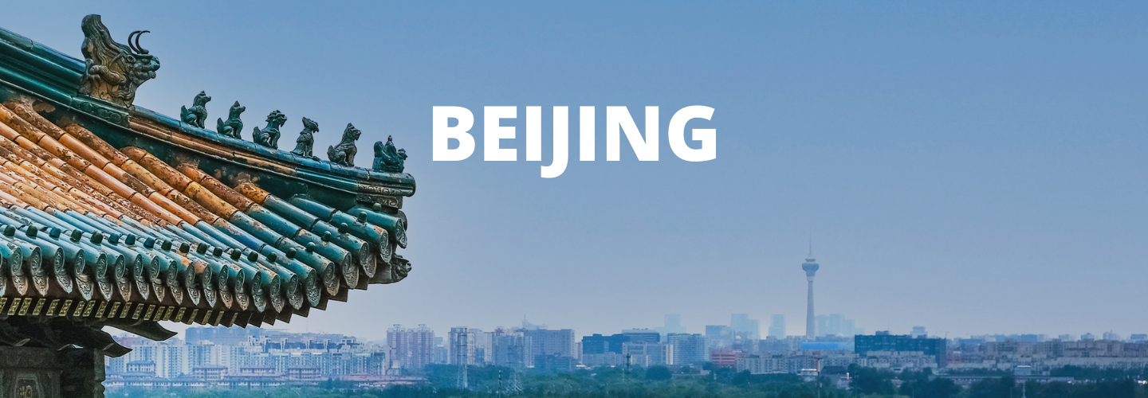
APAN5310 Team2

Slide 2
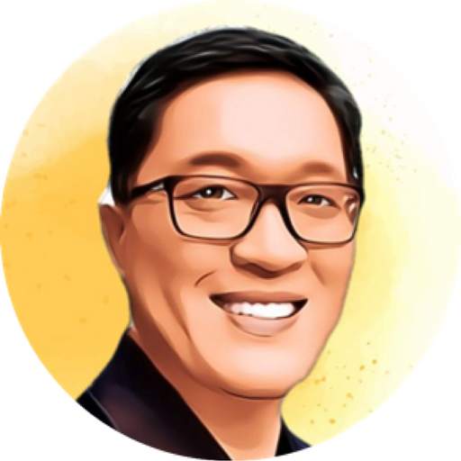
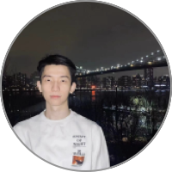
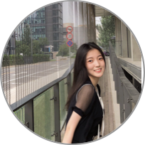

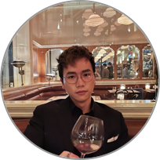

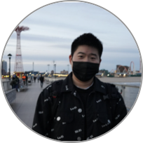
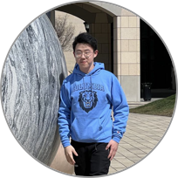
Group Members
Xu Feng
Zeying Liu
Ching-Ching Chan
Pro. Day Yi
Hangyu Li
Ziyi Weng
Chao Zhang
Xuchang Liu
Notes:
组员

Slide 3
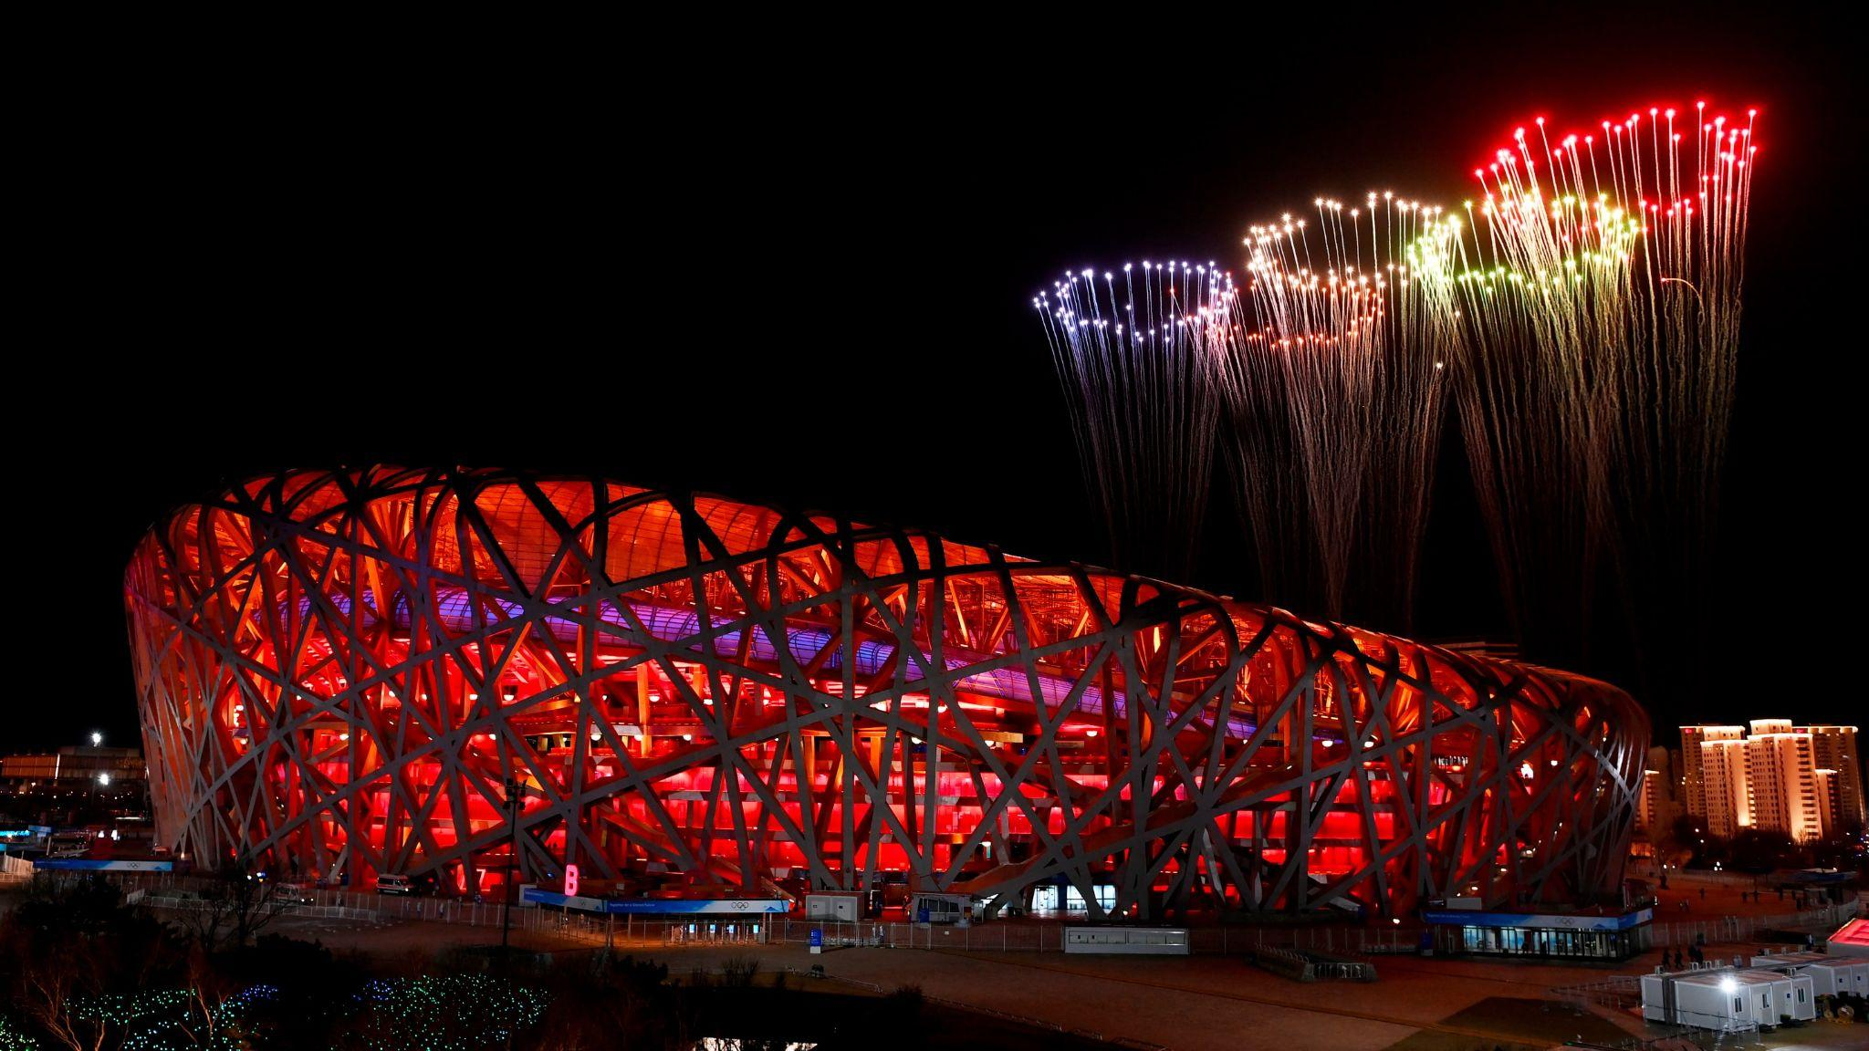


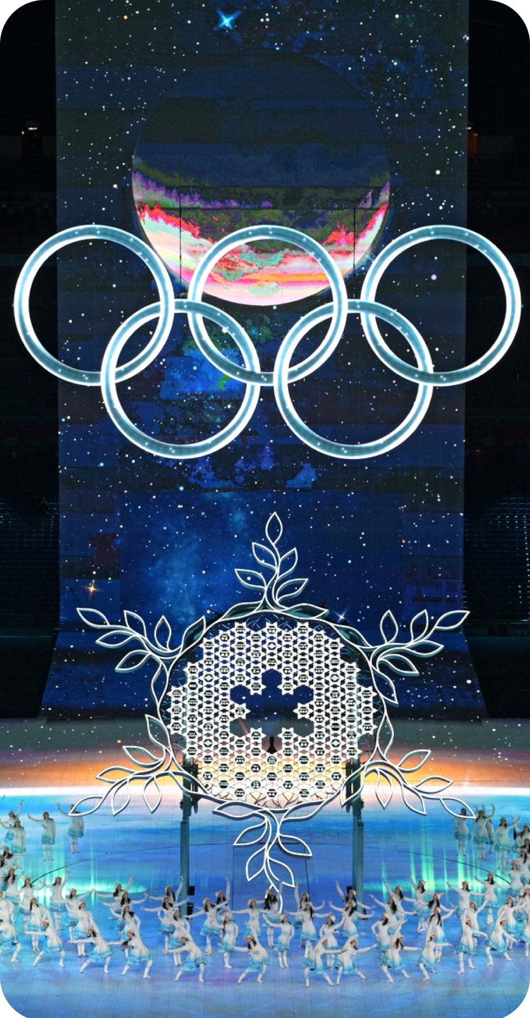
Beijing
INtroduction
2
Olympic Games
Capital of China
Time-honored history and civilization:
the Great Wall (Changcheng)
the Forbidden City (Gugong)
the Temple of Heaven (Tiantan)
Modernization and international:
Olympic Games (Summer & Winter)
Universal Resort
3000
Years Hist0ry

Slide 4
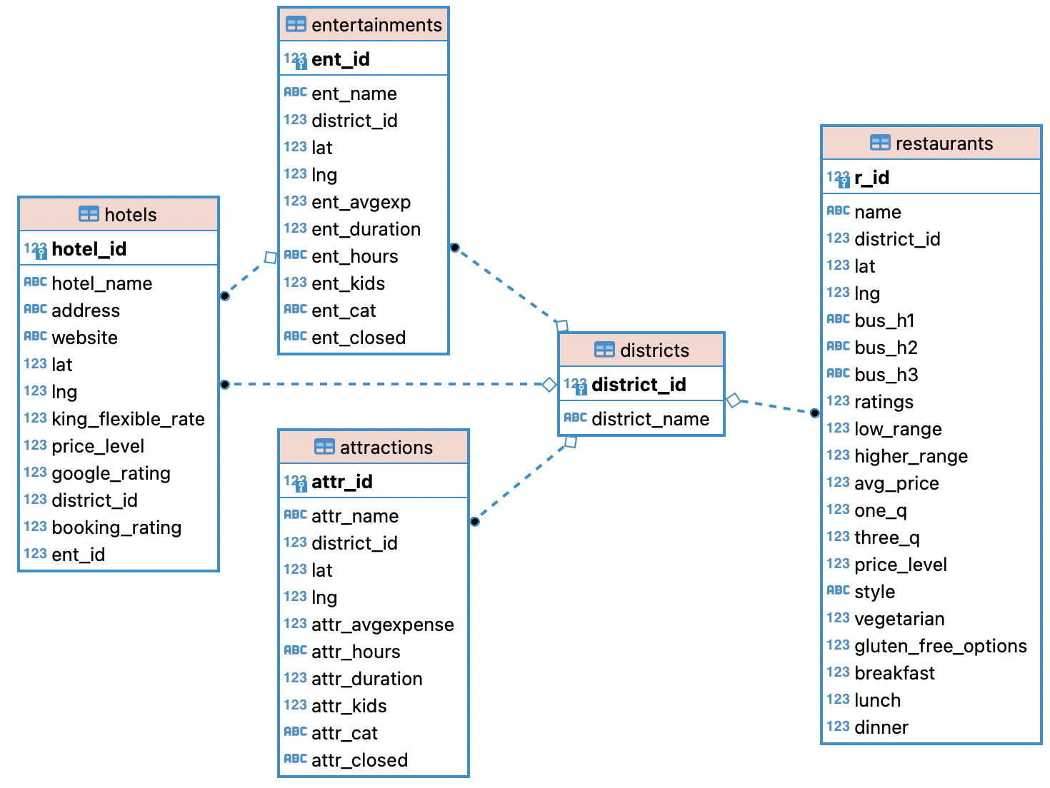
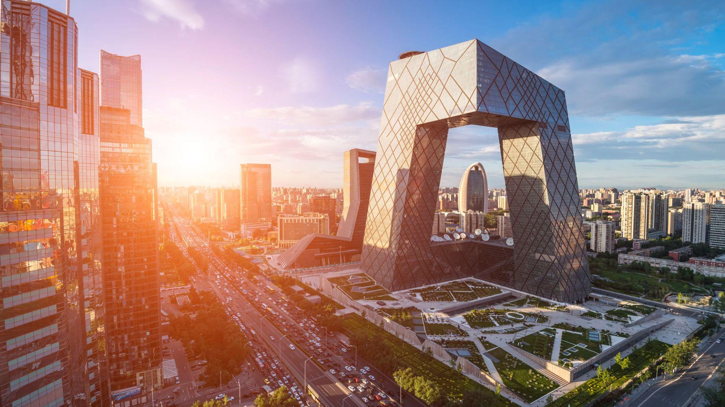
Data we used
Hotel
Attraction
Restaurant
Entertainment
Notes:
展示数据

Slide 5
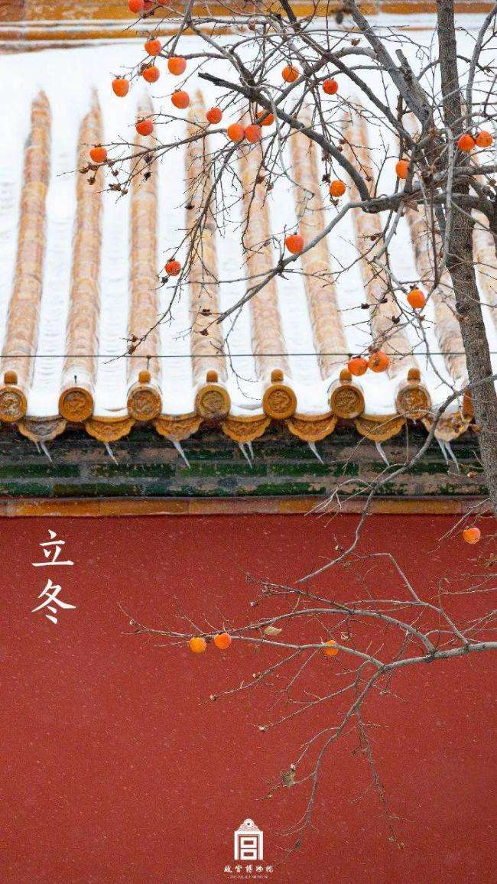
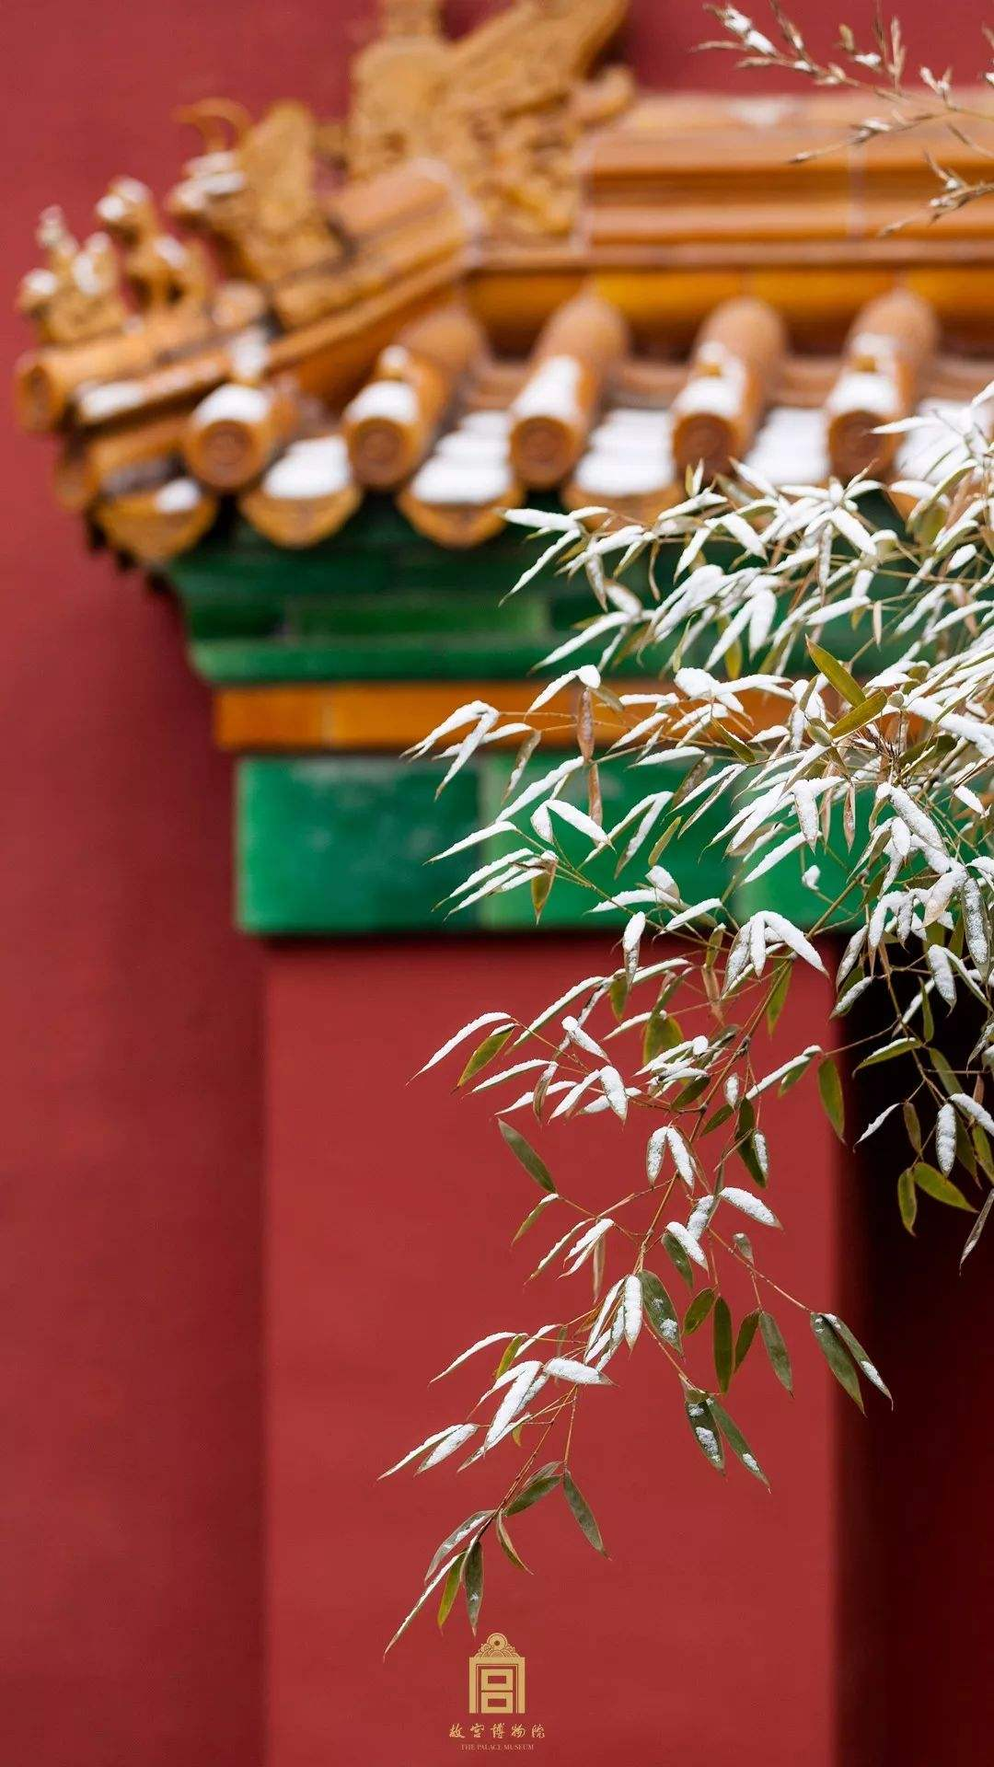
Shiny Demo
Notes:
Shiny app

